Slide 1
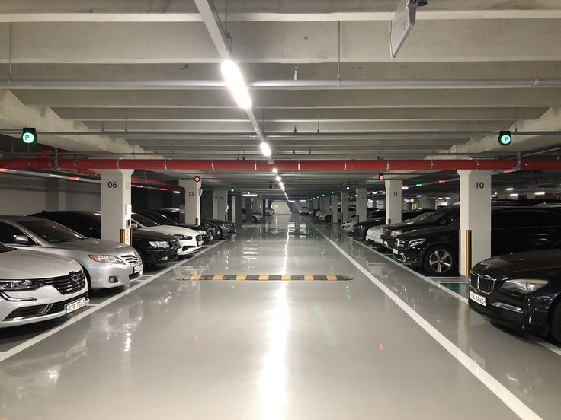
Predicting Parking Blocks Occupancy in Seattle Using Machine Learning
Team Members:
Raphael Ugboko, Cary Dill, Hank Lin

Slide 2
Problem Definition & Project Overview
Seattle relies heavily on paid street parking, but the problem is that drivers often waste time searching for available spots. The overview of our project is to predict whether a blockface will be full at a specific time based on pricing, time, weather, and capacity.
Why the project is useful
Our predictions will achieve the following:
Help to optimize parking guidance systems
Reduce congestion and emissions
Support city decision-making for pricing and zoning

Slide 3
Summary of CP1 → CP2 → CP3 progress
CP1 – Data Understanding & Framing the Problem
Selected the Seattle Parking Dataset and defined the prediction target (is_full).
Conducted initial EDA to understand variables, time patterns, and data limitations.
Established the binary classification framing for predicting full parking blocks.
CP2 – Baseline Modeling
Built the first predictive model using Logistic Regression.
Engineered time, weather, and parking features.
Evaluated baseline performance using a train-test split and computed first test error rate.
CP3 – Benchmarking With Alternative Models
Implemented and compared Decision Tree and Random Forest models.
Benchmarked against Logistic Regression using consistent test error estimation.
Generated predictions for three example scenarios and compared models side-by-side.

Slide 4
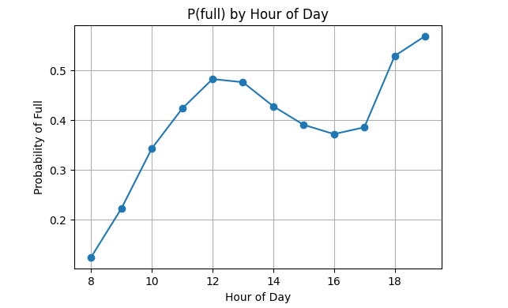
Dataset & Exploratory Data Analysis (EDA)
We used the Seattle Parking Dataset hosted by Arundhati-vt on Kaggle and it had a size of 50.61 GB and had 56 CSV files.
Dataset Summary
Balanced working sample: 279,062 rows, 19 features
Target variable: is_full (1 = full, 0 = not full)
Adaptive threshold for fullness: PaidOccupancy ≥ 8.0
Key EDA Insights:
Fullness peaks around 11 AM–1 PM and again 5–7 PM
Demand is driven by a dual mechanism: Commuters in the morning and Social/Dining in the evening. This complexity confirms that simple linear models are insufficient
Fridays and weekends have the highest fullness
Cheaper parking fills faster

Slide 5
Preprocessing Decisions and Justifications
Preprocessing Decision | Action Taken | Justification
Column Selection | We removed high-cardinality text fields (e.g., blockface names) and retained numeric features such as time, weather, rate, and capacity. | This keeps the model computationally efficient and avoids noise during fast benchmarking.
Parsing Dates & Feature Engineering | We extracted year, month, day, day-of-week, and hour from OccupancyDateTime. | Parking behavior is strongly time-dependent, and these features capture daily and weekly cycles.
Balancing the Target Variable | We created a balanced subset by sampling equal proportions of full and not full rows. | This prevents the model from being biased toward predicting “not full,” which dominates the raw dataset.
Adaptive Thresholding for “Fullness” | We defined is_full = 1 when PaidOccupancy ≥ 8, based on the empirical distribution. | Signal extraction where the threshold is chosen using natural breaks in the data instead of arbitrary cutoffs.

Slide 6
Baseline Model - Logistic Regression (CP2)
We used Logistic Regression for our baseline model and we selected it because:
The response is binary, which makes logistic regression appropriate.
Logistic regression trains quickly and produces stable baselines.
It models the log-odds of is_full as a function of engineered time features, price and capacity, coarse location, and weather. This choice aligns with standard practice for binary outcomes and serves as a strong benchmark before considering non-linear models.
Metric | Cross- Validation | Test Set
Accuracy | 0.8801 | 0.861
F1-Score | 0.6081 | 0.825
ROC-AUC | 0.8381 | 0.899
Precision | 0.842 | 0.838
Recall | 0.806 | 0.812
Test Error Rate |  | 13.9%
Training Accuracy: 0.88 vs Test accuracy: 0.86 (minimal overfitting)
70/30 train test split to maintain class balance

Slide 7
Benchmark Model
We used Random Forest and Gradient Boosting Classifier for our benchmark models which were tested to compare against the Logistic Regression baseline. The justifications are:
Random Forest captures complex interactions in parking behavior, reduces overfitting, and provides stable, reliable benchmark comparisons.
Gradient Boosting sequentially builds trees, corrects errors, captures subtle parking demand trends, offering strong benchmark accuracy.
Metric | Logistic Regression (Baseline) | Random Forest | Gradient Boosting
Accuracy | 0.861 | .8087 | .8787
F1-Score | 0.825 | .6977 | .5416
ROC-AUC | 0.899 | .8901 | .8051
Test Error Rate | .139 | .1913 | .1213
Notes:
The Random Forest classifier was chosen because it captures complex, non-linear patterns that a linear model cannot. Parking behavior depends on interactions between time, pricing, and capacity, and Random Forest handles these relationships naturally through its ensemble of trees. By averaging many trees, it also reduces overfitting, giving a more stable and reliable benchmark for comparison.
The Gradient Boosting classifier was included because it is one of the most accurate methods for structured tabular data. It builds decision trees sequentially, allowing it to learn from and correct previous errors. This makes it particularly good at capturing subtle trends in parking demand, especially during peak hours or under varying rate conditions, making it a strong benchmark for evaluating performance gains over simpler models.

Slide 8
Interpretation of Results
Strengths of Random Forest:
ROC-AUC (0.8901) - Best discrimination ability between full/not-full block faces
Macro F1 (0.6977) - Best balance with minority class performance
Practical utility - In the high-demand test case, RF predicted 59.72% probability vs. Logistic 17.63%, making it more actionable for real-world use
Weaknesses of Random Forest:
Raw Accuracy - Logistic Regression achieves 88.01% vs. RF's 80.87%
Interpretability - Logistic Regression is more transparent
Final Conclusion:
Best Model: Random Forest
High discriminative power (ROC-AUC = 0.89)
Superior treatment of minority class (Macro-F1 = 0.6977)
Most reliable for operational decision making in parking forecasting
Notes:
-Random forest achieved highest ROC-AUC at .89
Meaning it has the best ability to discriminate between full and not full blockfaces
- Random forest also had best Macro F1 score
Meaning it maintains the best balance when predicting the minority class
- In our high demand test cases - a busy downtown block at 7pm - Random forest predicted 60% probability of being full while logistic regression predicted 18%.
- Raw forest has lower accuracy compared to logistic regression and is less interpretable than logistic regression
- Random Forest is our best model
For parking forecasting a missing full block is much more costly than a false alarm
With ROC-AUC and Macro F1 score mean its most reliable for decision making

Slide 9
Future work
Add categorical encoding for PaidParkingArea and PaidParkingSubArea
Perform hyperparameter tuning
Deploy model or integrate into a simple web app
Explore Palmetto for deep learning experiments
Notes:
Moving forward
We will add neighborhood level categorical encoding, perform extensive parameter
deploy the model as a web or mobile app for real time parking guidance
Explore Palmetto cluster to capture more complex temporal patterns

Slide 10

THANK YOU!

